Slide 1
Chapter 5: Will Your Future Be in Cybersecurity?
Instructor Materials
Introduction to Cybersecurity v2.1
Notes:
Cisco Networking Academy Program
Introduction to Cybersecurity v2.1
Chapter 5: Will Your Future Be in Cybersecurity?

Slide 2
Instructor Materials – Chapter 5 Planning Guide
This PowerPoint deck is divided in two parts:
Instructor Planning Guide
Information to help you become familiar with the chapter
Teaching aids
Instructor Class Presentation
Optional slides that you can use in the classroom
Begins on slide # 8
Note: Remove the Planning Guide from this presentation before sharing with anyone.
Notes:
2

Slide 3
Chapter 5: Will Your Future Be in Cybersecurity?
Introduction to Cybersecurity v2.1 Planning Guide
Notes:
Cisco Networking Academy Program
Introduction to Cybersecurity v2.1
Chapter 5: Will Your Future Be in Cybersecurity?

Slide 4
Chapter 5: Activities
What activities are associated with this chapter?
Page # | Activity Type | Activity Name
5.1.1.4 | Interactive Activity | What is My Hat Color?
Notes:
4

Slide 5
Chapter 5: Best Practices
Prior to teaching Chapter 5, the instructor should:
Complete Chapter 5, “Assessment.”
Review the Additional Resources and Activities document in the Student Resources for possible additional resources and activities.
The objectives of this chapter are:
Describe the legal and ethical issues facing a cybersecurity professional.
Notes:
5

Slide 6
Chapter 5: Additional Help
For additional help with teaching strategies, including lesson plans, analogies for difficult concepts, and discussion topics, visit the Community Forums .
If you have lesson plans or resources that you would like to share, upload them to the Community Forums in order to help other instructors.
Notes:
6

Slide 8
Chapter 5: Will Your Future Be in Cybersecurity?
Introduction to Cybersecurity v2.1
Notes:
Cisco Networking Academy Program
Introduction to Cybersecurity v2.1
Chapter 5: Will Your Future Be in Cybersecurity?

Slide 9
Chapter 5 - Sections & Objectives
5.1 Cybersecurity Education and Careers
Explain the legal and ethical issues facing cybersecurity professionals
Describe the legal and ethical issues facing a cybersecurity professional.
Notes:
9
Cisco Networking Academy Program
Introduction to Cybersecurity v2.0
Chapter 5: Will Your Future Be in Cybersecurity?

Slide 10
5.1 Cybersecurity Education and Careers
Notes:
5 – Will Your Future Be in Cybersecurity?
5.1 – Cybersecurity Education and Careers

Slide 11
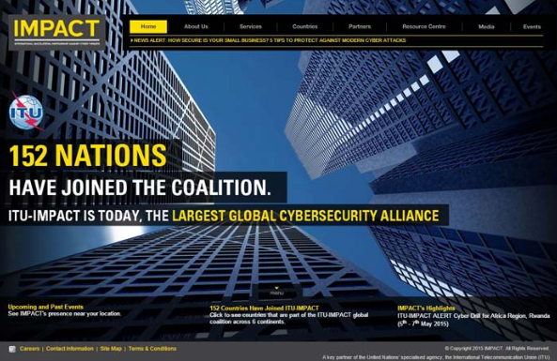
Legal and Ethical Issues in Cybersecurity Careers Legal Issues in Cybersecurity
Personal Legal Issues
Be responsible with your skills
Corporate Legal Issues
Businesses are required to abide by the cybersecurity laws.
Break the law, you could lose your job and your company could be punished.
When you are not sure, you should consult legal department.
International Law and Cybersecurity
IMPACT
global partnership of world governments, industries and academia
Improving global capabilities when dealing with cyber threats
Notes:
5.1 – Cybersecurity Education and Careers
5.1.1 – Legal and Ethical Issues in Cybersecurity Careers
5.1.1.1 – Legal Issues in Cybersecurity

Slide 12
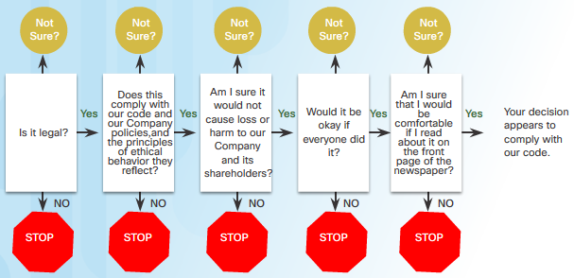
Legal and Ethical Issues in Cybersecurity Careers Ethical Issues in Cybersecurity
Personal Ethical Issues
Legal behavior may still be unethical.
Corporate Ethical Issues
Ethics are codes of behavior that are sometimes enforced by laws.
Organizations with Published Codes of Ethics:
The CyberSecurity Institute (CSI)
The Information Systems Security Association (ISSA)
The Association of Information Technology Professionals (AITP)
Notes:
5.1 – Cybersecurity Education and Careers
5.1.1 – Legal and Ethical Issues in Cybersecurity Careers
5.1.1.2 – Ethical Issues in Cybersecurity

Slide 13
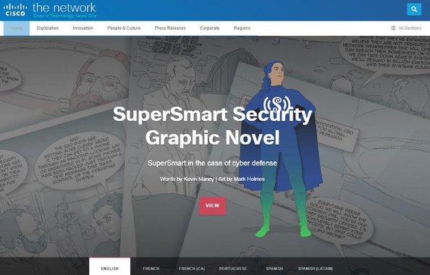
Legal and Ethical Issues in Cybersecurity Careers Cybersecurity Jobs
Some online job search engine
ITJobMatch
Monster
CareerBuilder
Different types of cybersecurity jobs
Penetration testing / ethical hacker
Security administrator
Network administrator
System administrator
Notes:
5.1 – Cybersecurity Education and Careers
5.1.1 – Legal and Ethical Issues in Cybersecurity Careers
5.1.1.3 – Cybersecurity Jobs

Slide 14
5.1 Chapter Summary
Notes:
5 – Will Your Future Be in Cybersecurity?
5.1 – Chapter Summary

Slide 15
Summary Chapter Summary
Describe the legal and ethical issues.
Notes:
5.2 – Summary
5.2.1.1 – Chapter summary

